Slide 1
SMART CAR PARKING SYSTEM USING IOT
TEAM MEMBERS:
SRIKANTH V 20ETCS002310
YASHAWANTH T M 20ETCS002312
TEJAS S 20ETCS002311
MALLIKARJUN 20ETCS002077
YASHAS M L 20ETCS002158

Slide 2
Introduction
The main aim of this project is reduces the risk of finding the parking slots in any parking area.
It eliminates the unnecessary travelling of vehicles across the filled parking slots in a city.
Smart Car Parking System is an integrated system to organize cars in public areas.
All vehicles enter into the parking and waste time for searching for parking slot .

Slide 3
Problem Definition
With increase in the population, number of vehicles increases and due to unmanaged parking it leads to many problems.
Proposed system
To find the parking space from any where by using the mobile application.

Slide 4
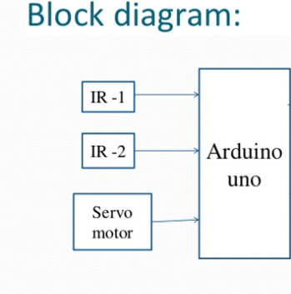
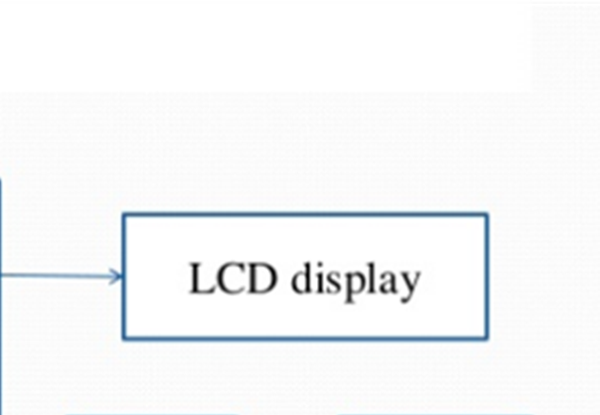

Slide 5
Component description
Hardware
Arduino UNO
IR Proximity Sensors
Servo Motor
16×2 LCD i2c Display
Jump Wires
Software
Arduino IDE

Slide 6
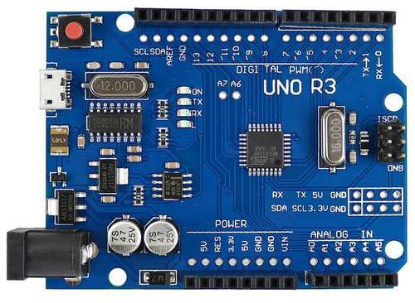
Arduino UNO The Arduino Uno is an open-source microcontroller board based on the Microchip ATmega328P microcontroller and developed by Arduino.cc and initially released in 2010.The board is equipped with sets of digital and analog input/output (I/O) pins that may be interfaced to various expansion boards (shields) and other circuits. The board has 14 digital I/O pins (six capable of PWM output), 6 analog I/O pins, and is programmable with the Arduino IDE (Integrated Development Environment), via a type B USB cable.

Slide 7
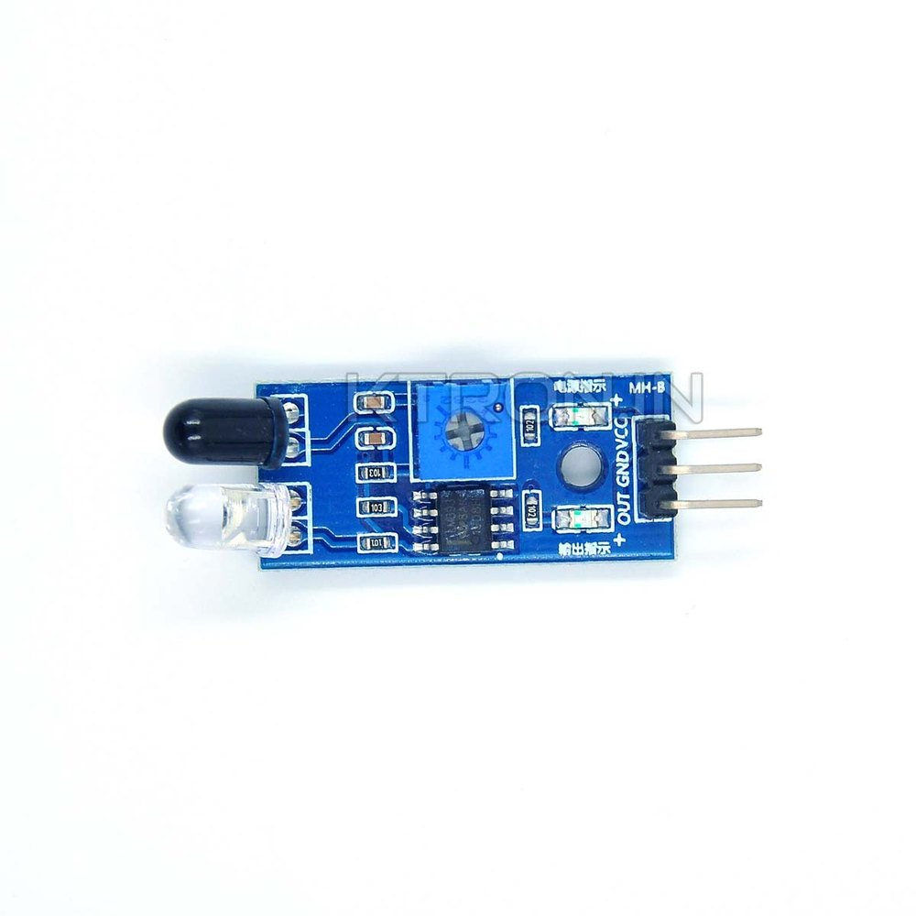
IR Proximity Sensor This IR Proximity Sensor is a multipurpose infrared sensor which can be used for obstacle sensing, color detection, fire detection, vehicle sensing,line sensing, etc… and also as an encoder sensor. The sensor provides a digital output.

Slide 8
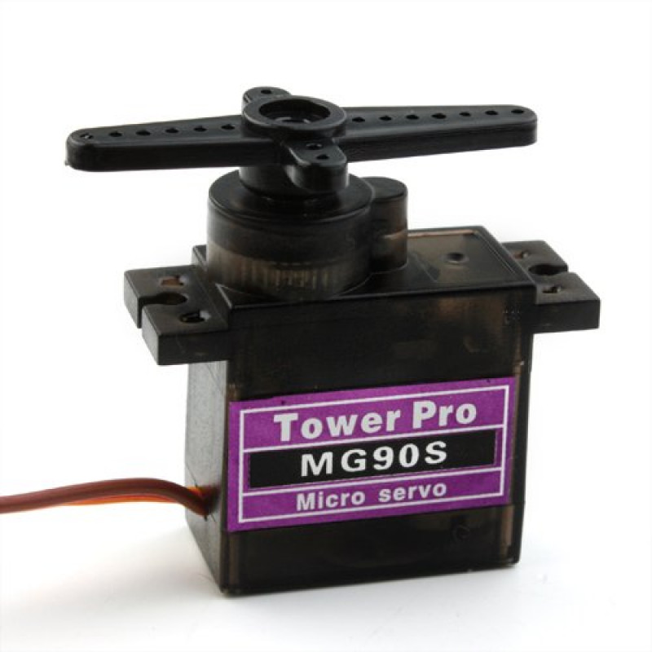
Servo Motor A servomotor (or servo motor) is a rotary actuator or linear actuator that allows for precise control of angular or linear position, velocity and acceleration.^{[1]} It consists of a suitable motor coupled to a sensor for position feedback. It also requires a relatively sophisticated controller, often a dedicated module designed specifically for use with servomotors.

Slide 9
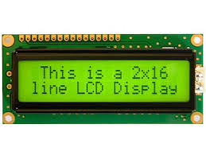
16×2 LCD i2c Display This is a 16x2 LCD display screen with I2C interface. It is able to display 16x2 characters on 2 lines, white characters on blue background. Usually, Arduino LCD display projects will run out of pin resources easily, especially with Arduino Uno. And it is also very complicated with the wire soldering and connection.

Slide 10
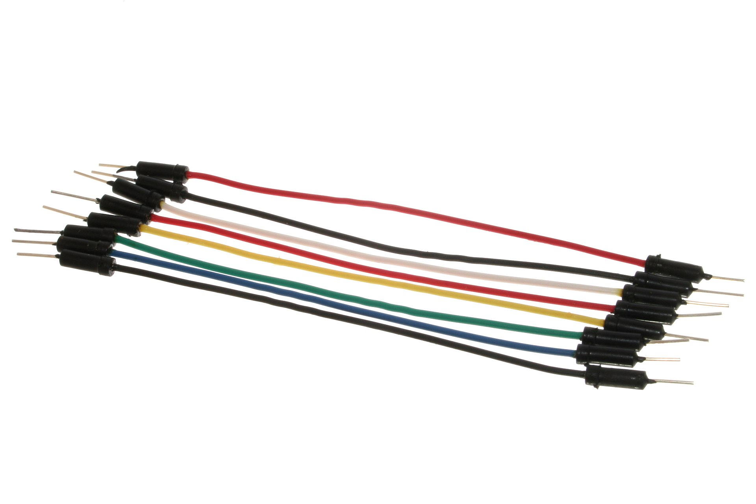
Jump Wires A jump wire (also known as jumper, jumper wire, DuPont wire) is an electrical wire, or group of them in a cable, with a connector or pin at each end (or sometimes without them – simply "tinned"), which is normally used to interconnect the components of a breadboard or other prototype or test circuit, internally or with other equipment or components, without soldering.

Slide 11
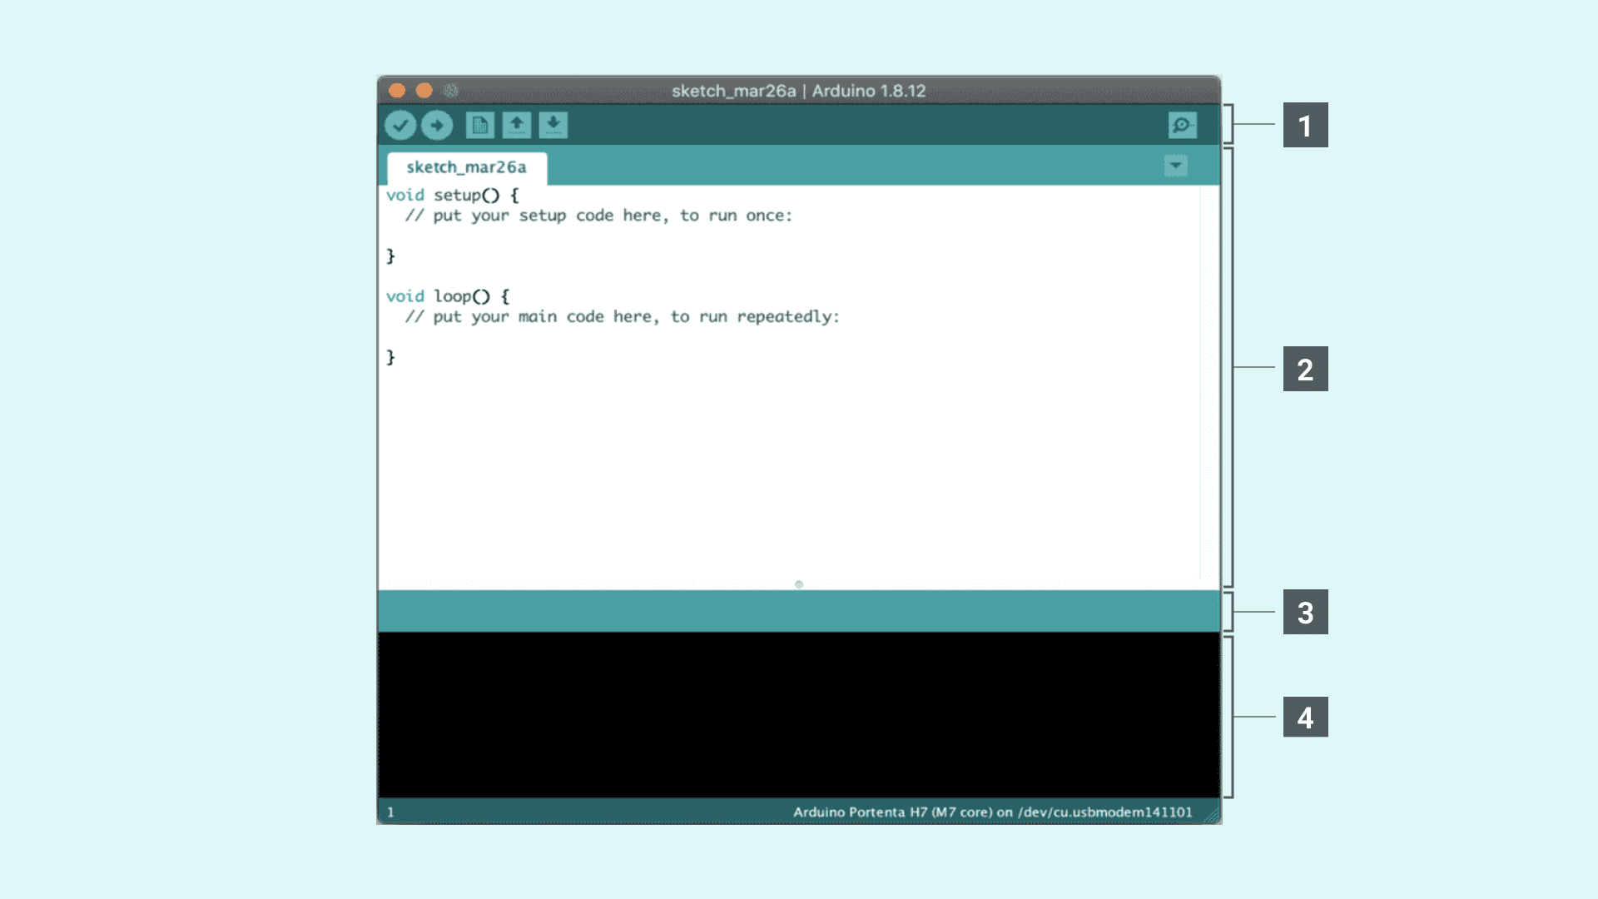
Arduino IDE The Arduino Integrated Development Environment - or Arduino Software (IDE) - contains a text editor for writing code, a message area, a text console, a toolbar with buttons for common functions and a series of menus. It connects to the Arduino hardware to upload programs and communicate with them.

Slide 12
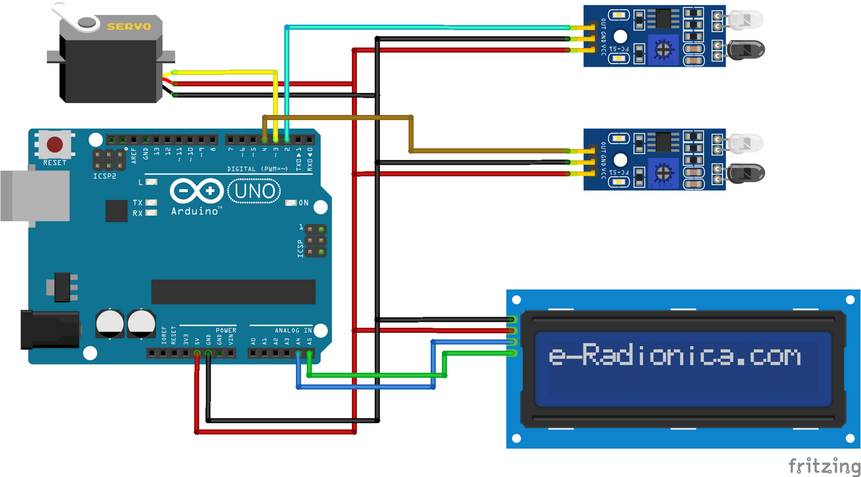
Circuit Diagram

Slide 13
Working
Step 1:
When car enters the parking area IR sensor that is present before IN gate will detects the passing vehicle and the gate will be opened automatically.
Step 2:
The car will enter into the parking area at that time person doesn't know which slot is empty, for this there will be an indication of LED's for slot. By this the person easily know which slot is empty.
Step 3:
The operation of exit side will be same as that of the entrance. When the car is leaving the parking area, the IR sensor that is present before the OUT gate will detect the passing vehicle and the gate will be opened automatically.
Step 4:
In front of the parking area, there will be an LCD display that is used to show the status of the parking slots, whether the parking is available or not.

Slide 14
Advantages Shorter waiting time at parking place. It saves fuel, money, space and time. Reduced pollution. Reduced traffic. Carbon emission is reduced. Efficiency Applications The smart car parking system can be implemented in: Shopping malls Restaurants Theatres

Slide 15
Conclusion
This project focuses on implementation of car parking place detection using Internet of Things.
The system benefits of smart parking go well beyond avoiding time wasting.
Developing a smart parking solutions with in a city solves the pollution problem.
Thank You

